Slide 1
Rails-03
3870

Slide 2
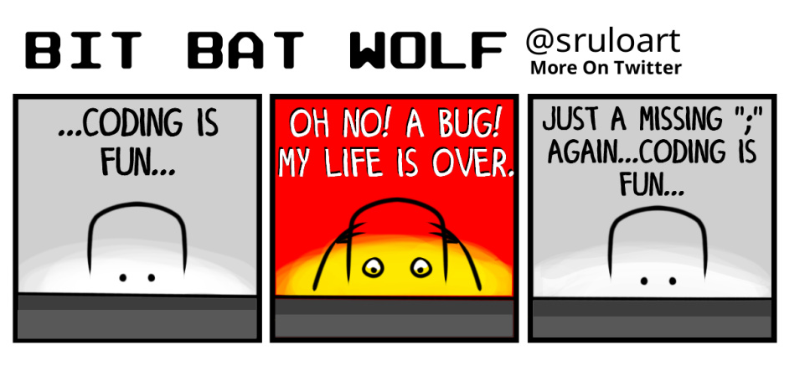

Slide 3
let's add a delete button!
# first put the following route
delete 'videos/:id' => 'videos#destroy' , as: :delete_video
# insert the following link where relevant
<%= link_to 'Delete Video', delete_video_path(video.id), method: :delete, data: { confirm: 'Are you sure?' } %>

Slide 4
delete method?
Modern browsers do not support PUT or DELETE but Rails "simulates" them

Slide 5
destroy action in controller
def destroy
Video.find(params[:id]).destroy
redirect_to videos_path , notice: "Video destroyed!"
end
Notes:
http://apidock.com/rails/ActionController/Base/redirect_to

Slide 6
flashing notice
Insert following tag in alert user that something as been destroyed
<p id="notice"><%= notice %></p>
or
<p id="notice"><%= flash[:notice] %></p>

Slide 7
Exercise
Create show buttons on the index page
The show button should take the user to a page that display the info for one particular item

Slide 8
CRUD
Okay! Let's do the last part of CRUD.
The edit action

Slide 9
edit/ update routes
# what is the difference between the two?
get 'videos/:id/edit' => 'videos#edit', as: :edit_video
post 'videos/:id' => 'videos#update', as: :update_video

Slide 10
form_tag in edit.html.erb
<h1>Edit Video</h1>
<%= form_tag update_video_path do %>
<p>
<%= label_tag :id, "ID" %>
<%= text_field_tag :id, @video.id %></br>
<%= label_tag :user, "User" %>
<%= text_field_tag :user, @video.user %></br>
<%= label_tag :link, "Link" %>
<%= text_field_tag :link, @video.link %></br>
<%= label_tag :comment, "Comment" %>
<%= text_field_tag :comment, @video.comment %></br>
<%= submit_tag "Update Video" %>
</p>
<% end %>

Slide 11
controller actions for edit/update
def edit
@video = Video.find(params[:id])
end
def update
v = Video.find(params[:id])
v.update(user: params[:user], link: params[:link], comment: params[:comment])
end

Slide 12
Exercise
Practice CRUD on your individual project

Slide 13
Something different!
Let's install the fortune and cowsay program in Linux
sudo apt-get install fortune-mod
sudo apt-get install cowsay
Try executing the "fortune" and "cowsay" command
Do they work?

Slide 14
Command not found
Unfortunately the programs are in the
/usr/games directory
We can verify this by running
dpkg –L fortune-mod
How do we add /usr/games directory to the PATH?

Slide 15
Updating PATH variable
Try printing to current PATH:
echo $PATH
Go to HOME directory
cd $HOME # or cd ~
Show hidden files
ls –a
Open .profile file

Slide 16
Updating PATH variable 2
Update .profile with /usr/games
directory in the PATH
We will do this together
After updating the PATH, run the following command
source .profile
The source command runs the script
Notes:
http://superuser.com/questions/176783/what-is-the-difference-between-executing-a-bash-script-and-sourcing-a-bash-scrip/176788#176788

Slide 17
Running the commands
fortune
cowsay "ITEC 3870 Rocks!"
fortune | cowsay –f tux

Slide 18
Summer Reading
Read "The Art of Unix Programming"
http://www.catb.org/esr/writings/taoup/html/
to learn more about the culture, philosophy and humor of UNIX

Slide 19
Review
Deploying to Heroku (one more time)
This time we will run 'bundle install --without production'
What does the 'rails console' command do?

Slide 20
rails console
rails console provides a convenient way to access the models in your app
Try the following:
Grab all data from a model
Add an item to the model
Update an item in the model
Delete an item in the model

Slide 21
Nifty Heroku Commands
All your apps on Heroku
heroku apps
Find web URL of current Heroku project
heroku apps:info

Slide 22
Nifty Rake commands
rake routes
rake db:migrate
rake db:reset
rake db:rollback
rake db:seed

Slide 23
Common actions
index – list all items
show – show single item
new – new form for entry
edit – edit form
create – create a new item
update – update an item
destroy – delete an item

Slide 24
Problems with SQLite
Heroku has an ephemeral filesystem
(https://devcenter.heroku.com/articles/sqlite3ystem)
SQLite is not really designed to be used in a production system

Slide 25
let's reinstall postgresql first
# update apt-get repositories list
sudo apt-get update
# remove postgresql
sudo apt-get remove --purge postgresql-9.3
# install postgresql
sudo apt-get install postgresql-9.3

Slide 26
create user in postgresql
# become user 'postgres'
sudo su postgres
# create user 'ubuntu'
createuser ubuntu –interactive
# exit out of current shell
exit

Slide 27
postgresql supported
Now that we reinstalled postgresql
let's access it
# become user postgres
sudo su – postgres
# use postgresql console
psql
# psql commands
\l - list
\c – connect to database
\d – show all tables

Slide 28
postgresql supported 2
Heroku supports postgresql
You can access postgresql database on heroku using the commands:
heroku pg:psql
heroku pg:info

Slide 29
gem file to use pg
source 'https://rubygems.org'
gem 'pg', '0.17.1'
gem 'rails', '4.2.0'
gem 'bootstrap-sass', '3.2.0.0'
gem 'sass-rails', '5.0.1'
gem 'uglifier', '2.5.3'
gem 'coffee-rails', '4.1.0'
gem 'jquery-rails', '4.0.3'
gem 'turbolinks', '2.3.0'
gem 'jbuilder', '2.2.3'
gem 'sdoc', '0.4.0', group: :doc
group :development, :test do
gem 'byebug', '3.4.0'
gem 'web-console', '2.0.0.beta3'
gem 'spring', '1.1.3'
end
group :production do
gem 'rails_12factor', '0.0.2'
end

Slide 30
config/database.yml
default: &default
adapter: postgresql
pool: 5
timeout: 5000
development:
<<: *default
database: my_database_development
template: template0
test:
<<: *default
database: my_database_test
template: template0
production:
<<: *default
database: my_database_production
template: template0

Slide 31
Reading
Start reading Rails Tutorial starting from chapter 5

